Slide 1
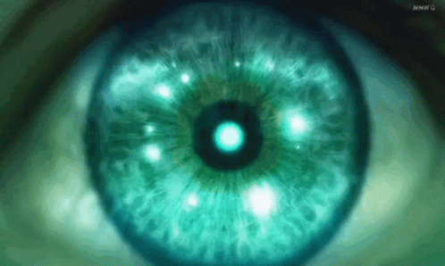
{Object}tive Vision:
Measuring the dimensions of objects in Real-Time
Ismail Akram
Tenzin Tashi
Computer Vision
CSc 471 Prof Zhu
Spring 2022
Notes:
Ismail
Good afternoon everyone,
We are Ismail Akram and Tenzin Tashi and our project is: {Object}tive Vision
The topic of our project is Measuring the dimensions of objects in Real-Time
Ismail 1-5 and 11 & 12
Tenzin 6-10

Slide 2
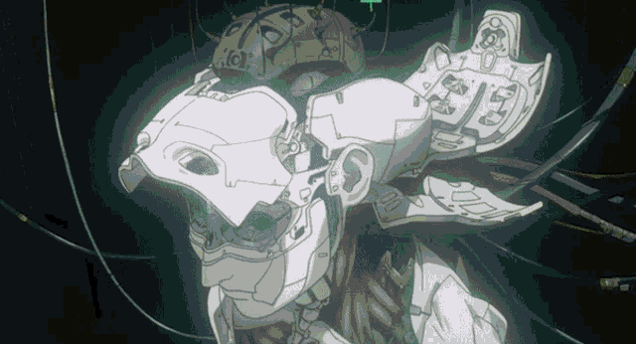
Problem:
Motive:
Create a practical tool for:
Tools and materials (engineering/surgical)
Supplements (medical)
Save time from using measuring devices
Goal: measure objects in real-time video.
Research: found projects measuring objects in respect to a reference object. We’ll expand on that concept.
https://pyimagesearch.com/2016/03/28/measuring-size-of-objects-in-an-image-with-opencv/
Focus: application > innovation
Notes:
Ismail
Why this needs to be done
The focus of this Computer Vision project is real-time video measuring.
Our motive is to measure objects efficiently and instantly.
The idea is to garner a seamless workflow in measuring tools and materials during application.
Basically, we want a virtual real-time blueprint.
This can have several practical applications in engineering/architectural/surgical (tools and materials), as well as medical (supplements) etc.
Although measuring objects using a reference has been done before, our focus is to build upon that foundation and net optimized real-time video feedback.

Slide 3
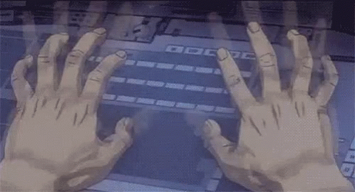



Our approach
Gaussian Blur
Canny edge detection
Finding contours
Euclidean distance (measure size)
Technologies:
OpenCV
Numpy
IOT Device (webcam)
Python
Notes:
Ismail
How you are going to do it, with algorithms, equations, figures
We plan on using the following concepts from our Image Formation, Feature Extraction, & Camera Calibration lectures:
Gaussian Blur
Canny edge detection
Finding contours
Euclidean distance
We will also be using the following technologies:
OpenCV and numpy as a base to expand upon.
The project will be done using Python, and IOT Device (webcam).

Slide 4
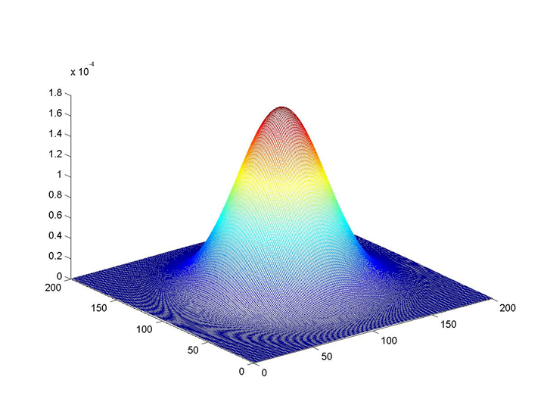
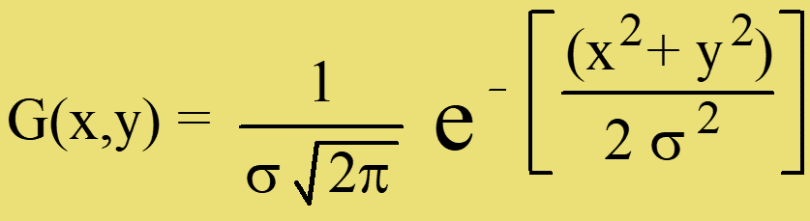
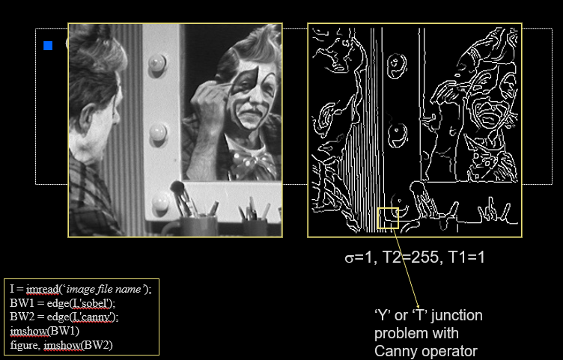
Step 1 Explanation:
Gaussian Blur & Canny Edge Detection
2D Gaussian distribution is defined by:
Fig 1: Gaussian distribution
Smoothing masks’ width depends upon σ.
Canny Edge Detection results in an edge map
Dilation & erosion to close gaps
Good detection & localization
One response per edge
Fig 2: Canny edge detection
Notes:
Ismail
What is Gaussian Blur?
Gaussian Blur: we smooth the image with 2D Gaussian distribution.
It has a number of important properties such as:
Why/how?
Linear scale when convolved with another Gaussian
Separable efficiency: as in, blurs small obstructive objects
And is the solution to the diffusion equation
What is Canny Edge Detection?
Canny Edge Detection: detects edges in an image and results in an edge map
Why/how?
Performs dilation & erosion to close gaps in between object lines
Edge detector based criteria
Good detection: minimum number of false negatives and false positives
Good localization: edge location must be close as possible to the correct position
Only one response per edge

Slide 5
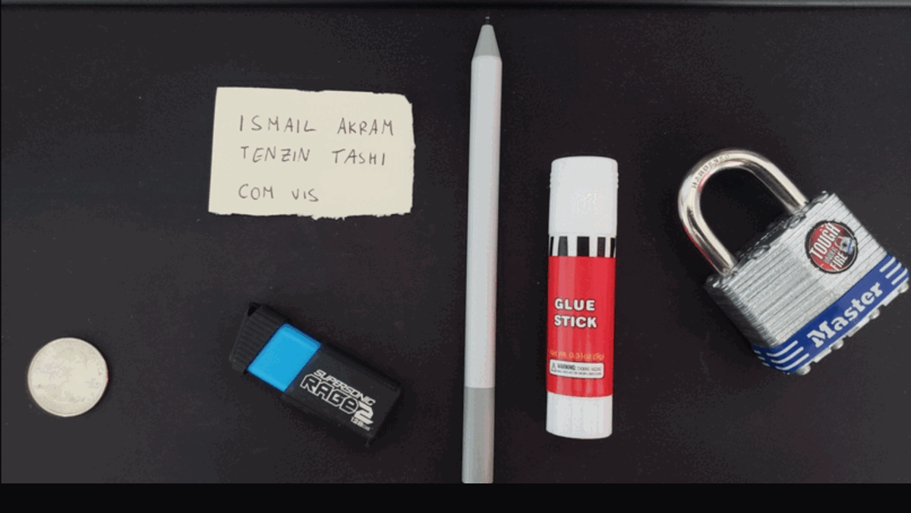
Implementation of Step 1:
Gaussian Blur & Canny Edge Detection
# perform gaussian Blur on a grayscale image
gray = cv2.GaussianBlur(gray, (7, 7), 0)
# perform edge detection, then perform a dilation + erosion to
# close gaps in between object edges
edged = cv2.Canny(gray, 50, 100)
edged = cv2.dilate(edged, None, iterations=1)
edged = cv2.erode(edged, None, iterations=1)
Fig: Gaussian Blur and Canny Edge Detection
Coin width = 0.995in
Notes:
Ismail
Blurring used to remove small noise, namely dust particles.
Note that we’re using a reference object, in this case, the coin in the bottom left which is set to 0.995 inches.

Slide 6
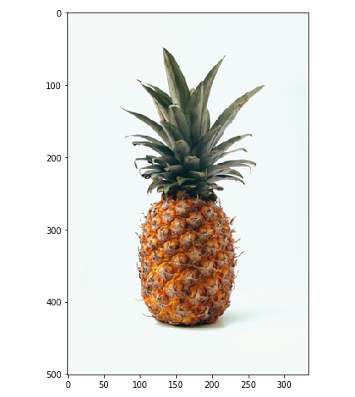
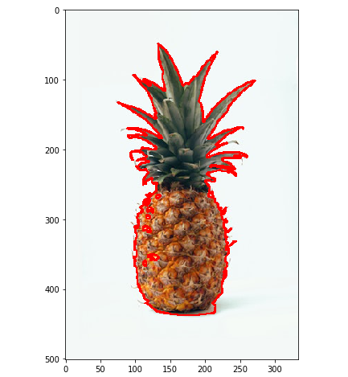
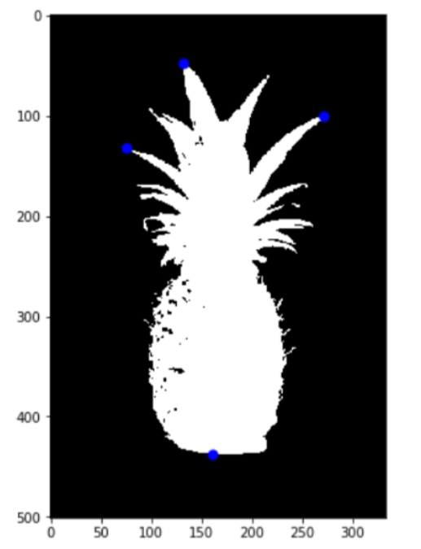
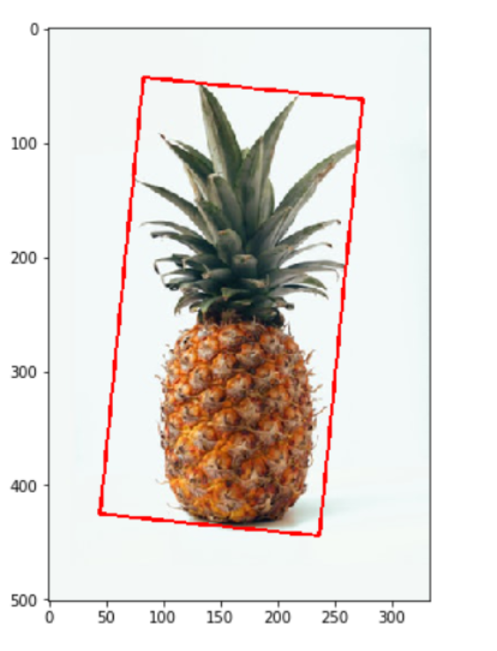
Step 2 Explanation:
Finding Contours
What are contours?
Curves created using continuous points.
Points found from same color or intensity.
Why we are using it?
Find the bounding box around the object
Fig 1: Original image
Fig 2: Contour Image
Fig 3: Contour Approximation
Fig 4: Draw rectangle
Notes:
Tenzin
What are contours?
According to the Open Source Computer Vision or simply known as OpenCV, contours can be explained simply as a curve joining all the continuous points (along the boundary), having same color or intensity.
Why we are using it?
The main reason of finding contours is to draw an outline around the object which we will be using to find the dimension.
How are we using it?
After getting the processed image from step 1
We first find the contour of the processed image as shown in the Fig 2
Then using the contour approximation we get the 4 end points as shown by the blue dot in the Fig 3
Finally we draw the rectangle using those four that we got from the Fig 3 as shown in the Fig 4.

Slide 7
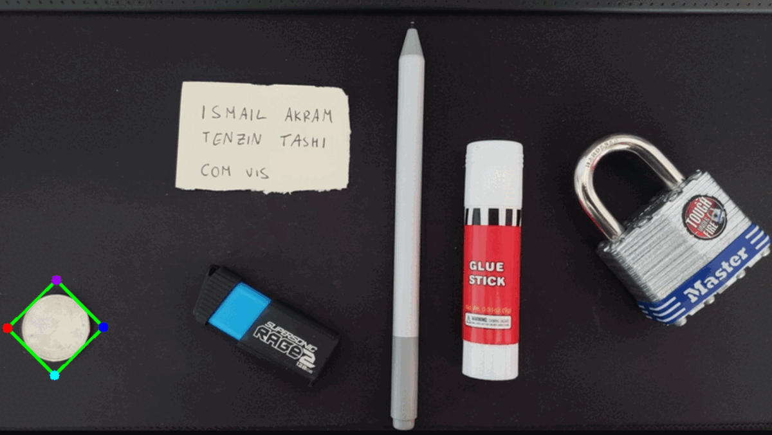
Implementation of Step 2:
Finding Contours
# find contours in the edge map
cnts = cv2.findContours(edged.copy(), cv2.RETR_EXTERNAL,
cv2.CHAIN_APPROX_SIMPLE)
cnts = imutils.grab_contours(cnts)
# sort the contours from left-to-right
(cnts, _) = contours.sort_contours(cnts)
Fig: Finding Contours
Notes:
Tenzin
The calculation of dimensions goes from left to right in a clockwise motion for each object. Bounding box (highlighted by the red, purple, navy, and blue coloured points)
Make sure to point out the blue in the USB as a slight “failure”*
continuous points (along the boundary), having same color or intensity.

Slide 8
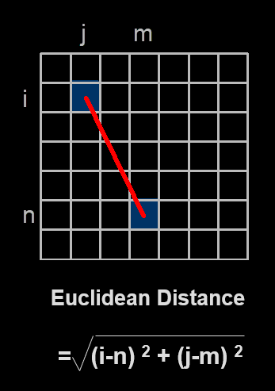
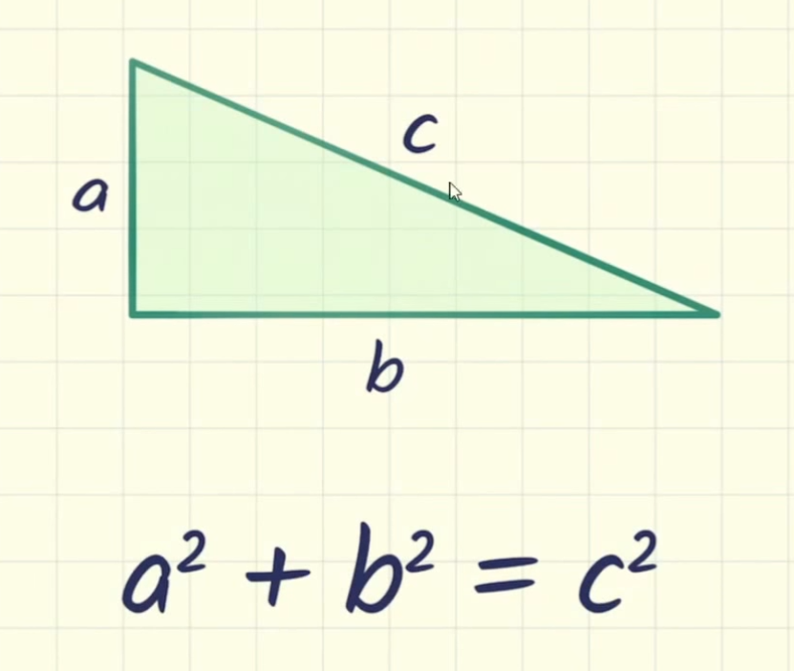
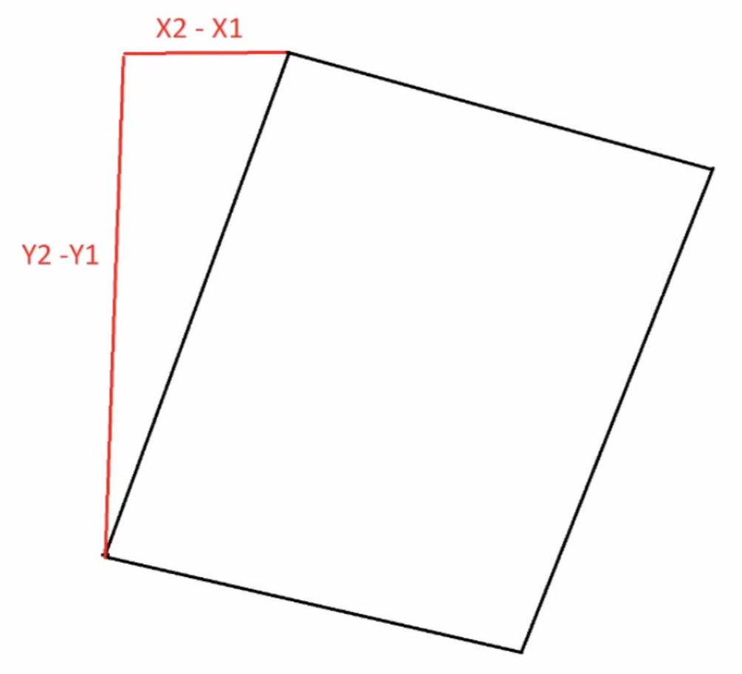
Step 3 Explanation:
Euclidean Distance
What is Euclidean Distance?
Commonly used metrics for finding distance
Square root of the sum of the squares of the differences between two points
Computationally expensive
Most accurate
Why are we using it?
Get the dimension (width & height) of an object
Fig 1: Euclidean Distance Formula
Fig 2: Calculating the width and height
Notes:
Tenzin
Digital Distances
What is Euclidean Distance?
As we learned in the class euclidean distance is one of the three metrics commonly used in computer vision for finding the distance between two points on the image plane.
The Euclidean distance metric is simply the square root of the sum of the squares of the differences in the coordinates of the two points
The computation of this metric requires real arithmetic and the calculation of a square root;
It is computationally expensive but the most accurate
Why are we using it?
To calculate the width and height of of the object

Slide 9
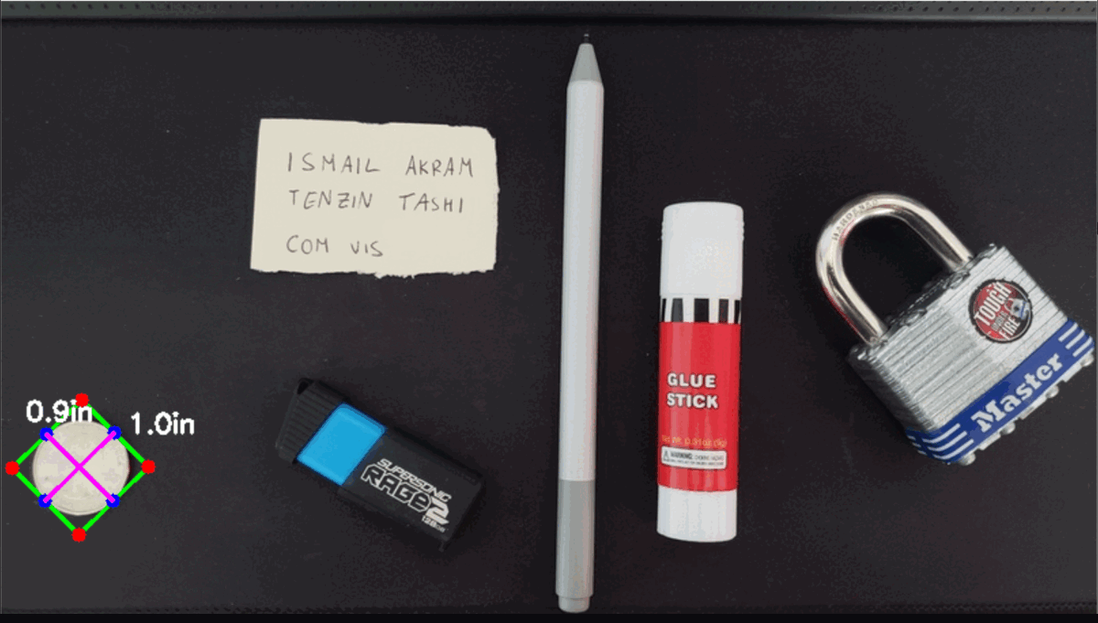
Implementation of Step 3:
Euclidean Distance
def findEuclidean(pts1, pts2):
return ((pts2[0]-pts1[0])**2 + (pts2[1]-pts1[1])**2)**0.5
for obj in conts2:
cv2.polylines(imgContours2, [obj[2]], True, (0, 255, 0), 2)
nPoints = utlis.reorder(obj[2])
nW = round((utlis.findEuclidean(nPoints[0][0]//scale,nPoints[1][0]//scale)/10), 1)
nH = round((utlis.findEuclidean(nPoints[0][0]//scale, nPoints[2][0]//scale)/10), 1)
Fig: Calculating the Euclidean Distance
Notes:
Tenzin
<Make sure you talk about calculation>

Slide 10
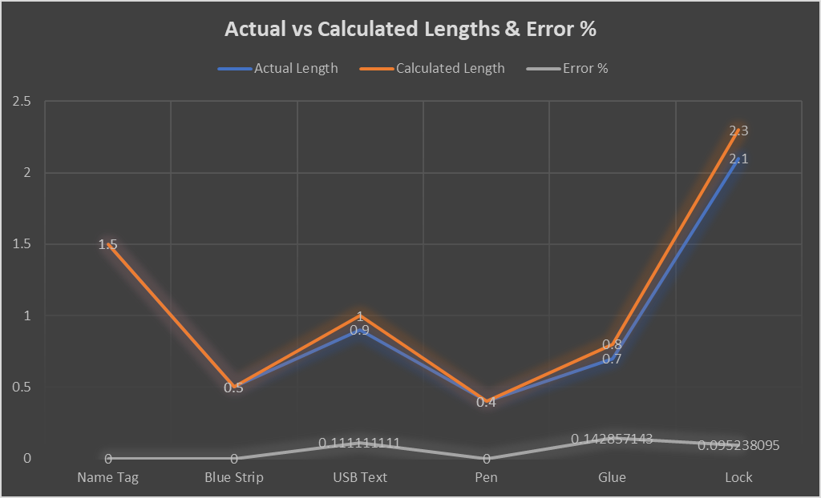
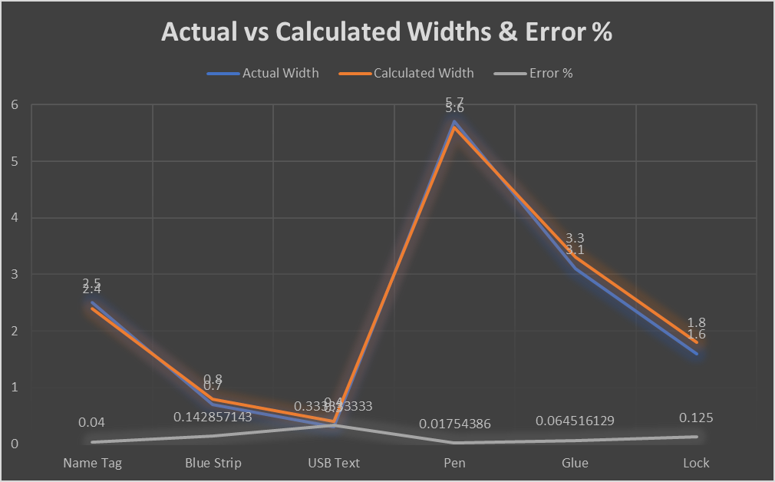
Result
Object | Actual Size | Calculated Size
Name Tag | 1.5in x 2.5in | 1.5in x 2.4in
Blue Strip | 0.5in x 0.7in | 0.5in x 0.8in
USB Text | 0.9in x 0.3in | 1.0in x 0.4in
Pen | 0.4in x 5.7in | 0.4in x 5.6in
Glue | 0.7in x 3.1in | 0.8in x 3.3in
Lock | 2.1in x 1.6in | 2.3in x 1.8in
Graph 1: Actual vs Calculated Lengths & Error %
Table: Actual Object Dimensions & Calculated Object Dimensions
Graph 2: Actual vs Calculated Width & Error %
Notes:
Tenzin
What you do, with images, tables, and numbers
As you can see, here are the table of results between actual object size measured with a ruler vs computer calculated size.
Our margin of error is on average 0.1%, so we have a precise approximation of our contours and euclidean measurements.

Slide 11
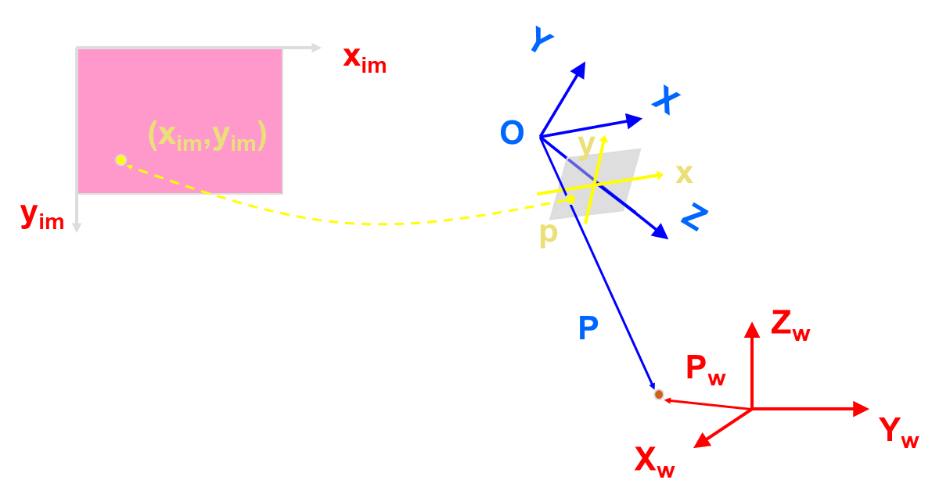
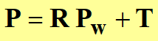
Calibrating for Real-Time video
Extrinsic: R & T; world frame -> camera frame
Intrinsic: internal camera parameters
Focal length
Converting to pixels
Notes:
Ismail
Measuring the size of objects in an image is similar to computing the distance from our camera to an object - In both cases, we need to define a ratio that measures the number of pixels per a given metric.
Extrinsic parameters are rotation and translation matrices used to convert something from the world frame to the camera frame
Intrinsic parameters are the internal camera parameters, such as the focal length, used to convert that information into a pixel
In our case the reference object is an A4 size paper whose dimension is 210x297 mm

Slide 12
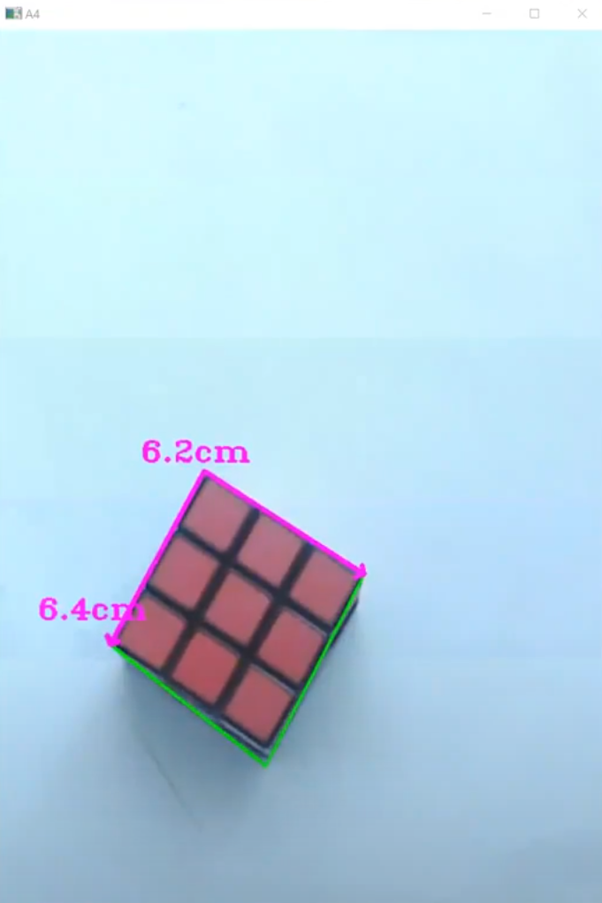
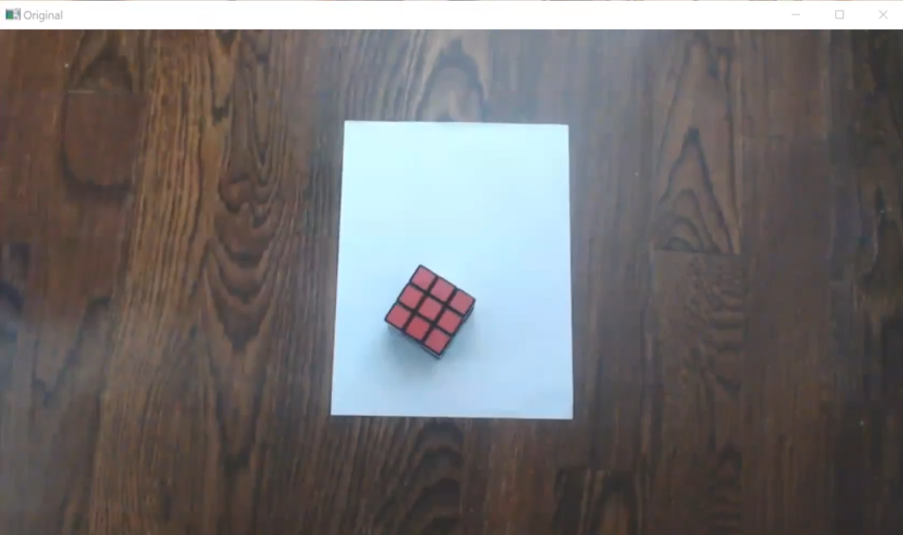
Conclusions
Reference object’s dimension:
must be known apriori.
Must be easy to detect for contours
Checkerboard camera calibration
Remove radial and tangential distortion
Fig 2: Original (distorted lens)
Fig 1: Calibrated
Notes:
Ismail
Itemized conclusions, observations, and discussions.
Reference object, whether within the frame as a coin or is the frame itself, needs known dimensions.
It must also be the first object that’s detected.
We initially did the project in a “pixels per metric” technique.
But after calibration for the real-time video segment, accounting for rotation and translation, our results were much closer to the object’s actual dimensions.

Slide 13

Demo
Notes:
Webcam recording
Left: calibrated, right: original webcam footage.

Slide 14
Thank you for listening
Any questions?

